Slide 1
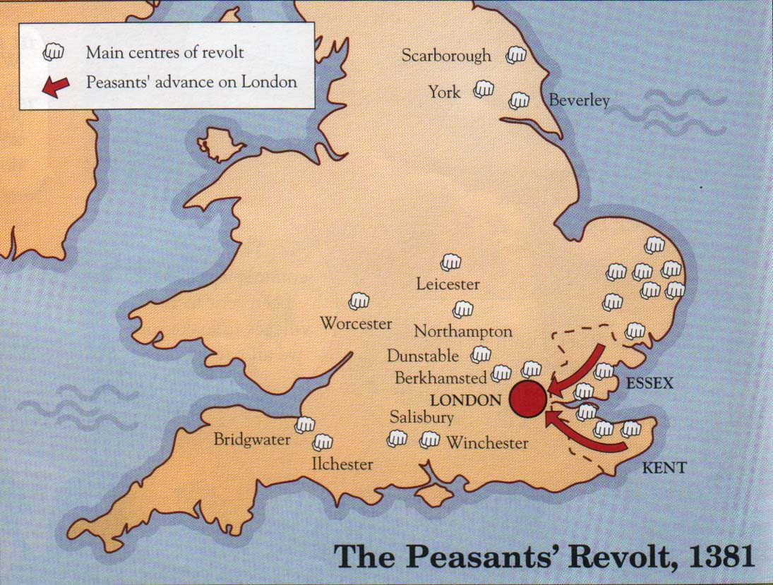
May 1381
King’s commissioners are attacked in Fobbing in Essex whilst trying to collect new poll tax. Three commissioners are beheaded and their heads put on poles and paraded around nearby villages.
Thousands of peasants meet in Maidstone and choose Wat Tyler, former soldier as their leader. He and his men take over the king’s castle at Rochester and march into Canterbury.

Slide 2
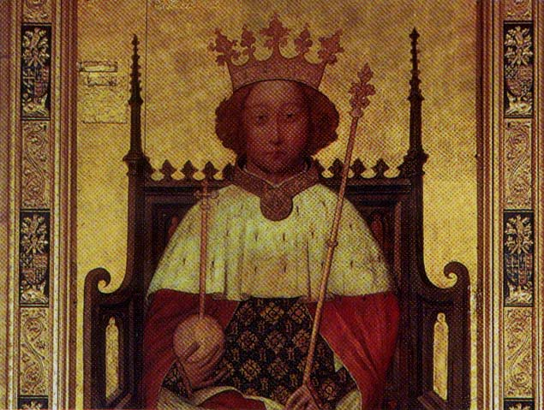
June 1381
Peasant numbers had reached about 60,000
Peasants are armed with axes, scythes, some even have swords and bows and arrows. They begin to march on London to demand an audience with the King.
Richard II (1377-99)

Slide 3
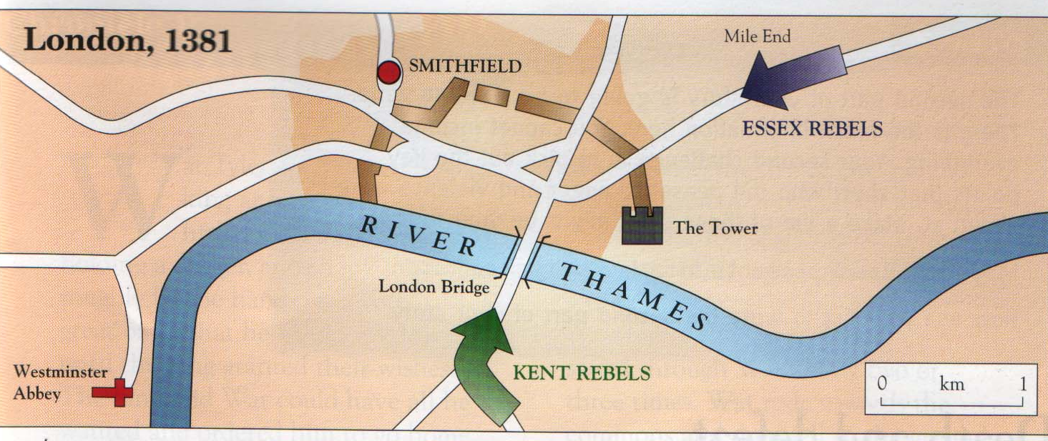
Thursday 13 June 1381
Poor Londoners help peasants get through city gates
They break into Savoy Palace, home of John of Gaunt, Duke of Lancaster, and blow it up with dynamite
During the night drunken rebels riot. They attack and destroy the houses of lawyers and foreign traders.

Slide 4
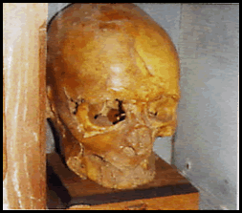
Friday 14 June 1381
Richard travels by boat along the Thames to meet rebels at Mile End. Amazingly, he agrees to abolish poll tax and grant free pardons if they go home immediately.
Peasants break into Tower of London, capture Sudbury & Hales and cut off their head (Sudbury’s takes 8 blows!)
Sudbury’s decapitated head, preserved in a parish church

Slide 5
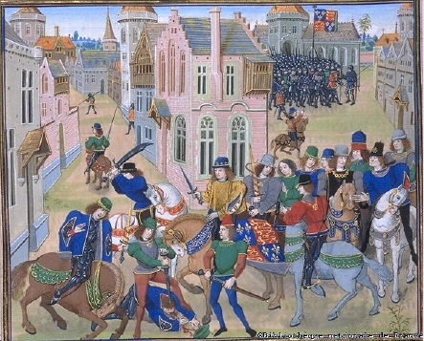
Saturday 15 June
King meets the rebels again, outside city walls at Smithfield.
Wat Tyler is killed under mysterious circumstances
Peasant leaders are rounded up and hanged.
The death of Wat Tyler

